Slide 1
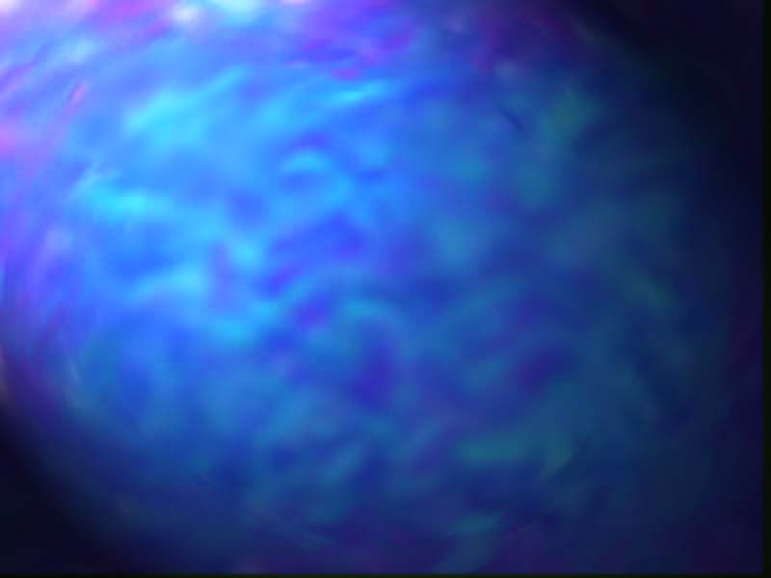
Ground Waves
Radio wave that travels along the earth’s surface (surface wave)
Vertically polarized
Changes in terrain have strong effect
Attenuation directly related to surface impedances
  More conductive the more attenuated
  Better over water

Slide 2
Attenuation related to frequency
  Loses increase with increase in frequency
  Not very effective at frequencies above 3 MHz
  Very reliable communication link
  Reception is not affected by daily or seasonal weather changes

Slide 3
Sky Waves

Slide 4
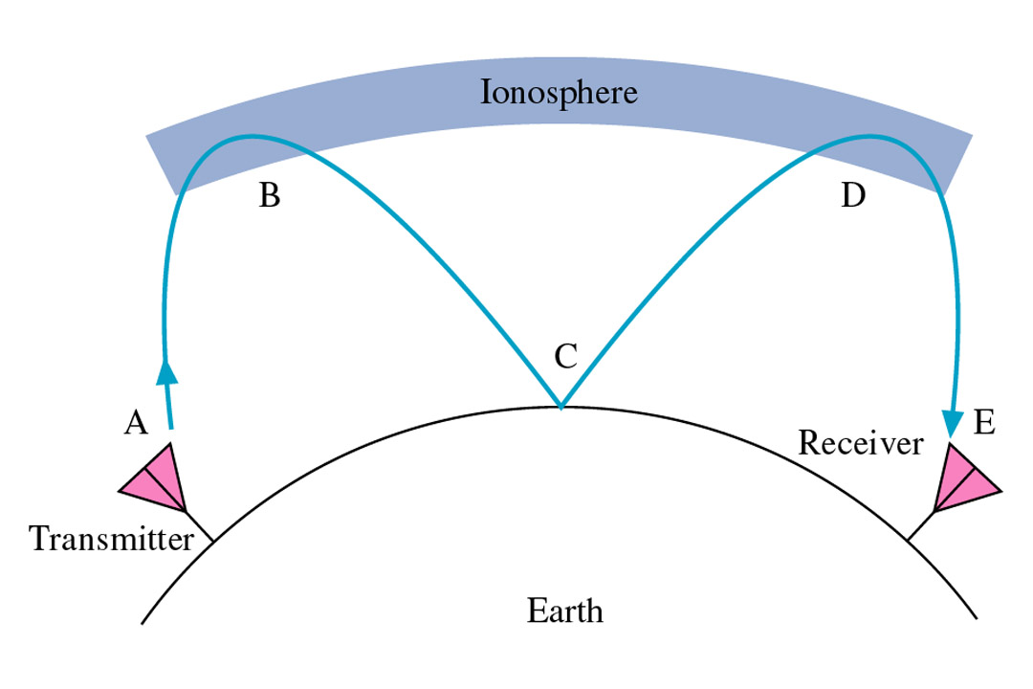
FIGURE 12-9 Sky-wave propagation.
Gary M. Miller, Jeffrey S. Beasley
Modern Electronic Communication, 7e
Copyright ©2002 by Pearson Education, Inc.
Upper Saddle River, New Jersey 07458
All rights reserved.

Slide 5
Radio waves radiated from the transmitting antenna in a direction toward the ionosphere
Long distance transmissions
Sky wave strike the ionosphere, is refracted back to ground, strike the ground, reflected back toward the ionosphere, etc until it reaches the receiving antenna
Skipping is the refraction and reflection of sky waves

Slide 6
Atmospheric Phenomenon
Three layers:
  Troposphere: earth’s surface to about 6.5 mi = 10.4 km
  Stratosphere: extends from the troposphere upwards for about 23 mi=36.8 km
  Ionosphere: extends from the stratosphere upwards for about 250mi=400 km
  Beyond this layer is free space

Slide 7
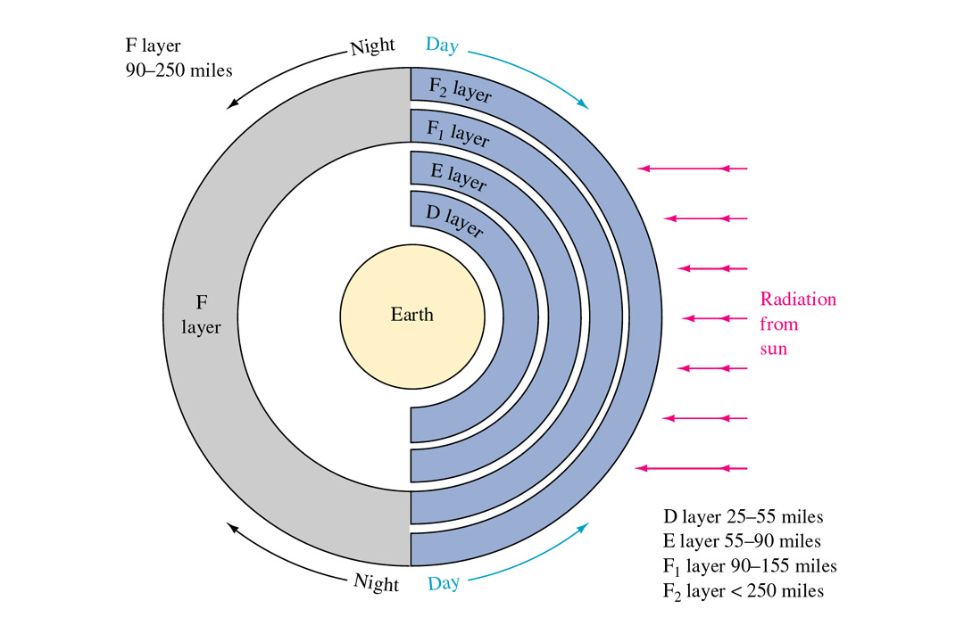
FIGURE 12-10 Layers f the ionosphere.
Gary M. Miller, Jeffrey S. Beasley
Modern Electronic Communication, 7e
Copyright ©2002 by Pearson Education, Inc.
Upper Saddle River, New Jersey 07458
All rights reserved.

Slide 8
Ionosphere
Three layers
  D: low frequencies can be refracted but the high frequencies tend to pass on through
  E: signals as high as 20MHz can be refracted while higher ones pass through
  F: during the day light hours there are two layers:
    F1 and F2

Slide 9
F: during the night hours the ionization layer is relatively constant and the higher frequencies can be refracted
During the night hours, the D and E layers virtually disappear and signals that would be refracted at lower levels now are refracted at higher levels.
This results in greater skip distances and better reception at greater distances than in the daytime hours.

Slide 10
Ionosphere
The layers that form the ionosphere vary greatly in altitude, density, and thickness with the varying degrees of solar activity.
The upper portion of the F layer is most affected by sunspots or solar disturbances
There is a greater concentration of solar radiation during peak sunspot activity.
The greater radiation activity the more dense the F layer and the higher the F layer becomes and the greater the skip distance

Slide 11
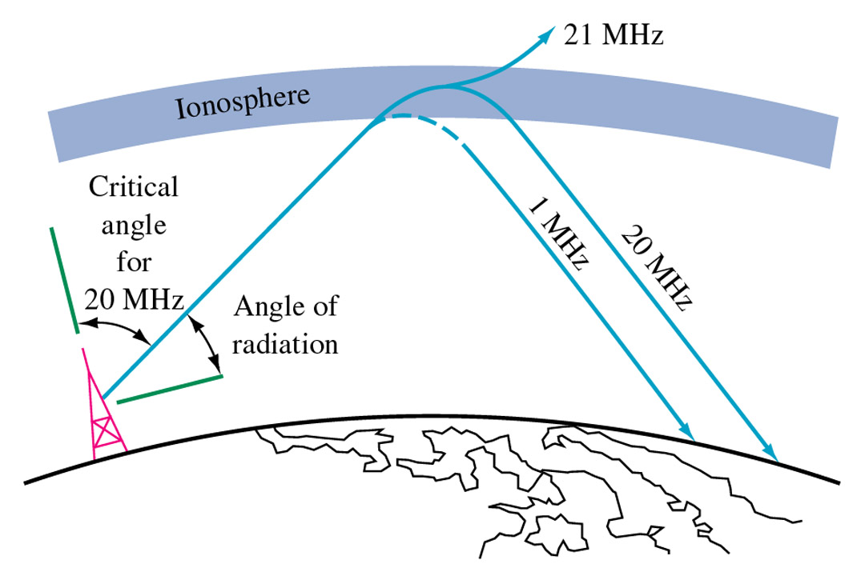
FIGURE 12-11 Relationship of frequency to refraction by the ionosphere.
Gary M. Miller, Jeffrey S. Beasley
Modern Electronic Communication, 7e
Copyright ©2002 by Pearson Education, Inc.
Upper Saddle River, New Jersey 07458
All rights reserved.

Slide 12
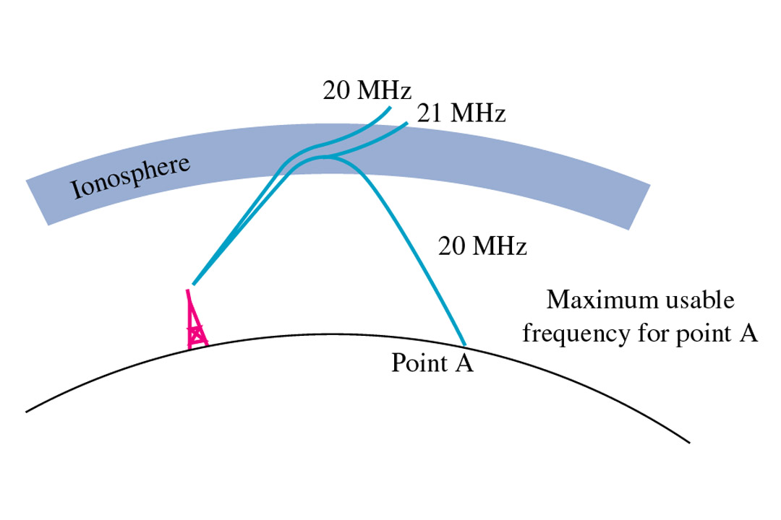
FIGURE 12-12 Relationship of frequency to critical angle.
Gary M. Miller, Jeffrey S. Beasley
Modern Electronic Communication, 7e
Copyright ©2002 by Pearson Education, Inc.
Upper Saddle River, New Jersey 07458
All rights reserved.

Slide 13
How Does HF Radio Work Over Long Distances?
An HF signal transmitted from the earth may travel some way through the ionosphere before being "bent" back down towards the ground. This occurs due to the interaction between the HF signal and electrically charged particles in the ionosphere. The signal can then "bounce" off the ground back into the ionosphere, return to the earth again, and so on. The distance a given HF signal will travel depends on the frequency, transmitter power, take-off angle relative to the ground and the state of the ionosphere through which it is travelling.

Slide 14
For any given distance and time, there will be a certain range of HF frequencies that are most likely to provide successful communications; frequencies outside that range will work poorly or not at all. Simply increasing the power of an HF signal will not help if the frequency is too high for the distance required. Increasing the power may help if the frequency is too low, but using a higher, more suitable frequency is the best option. The highest frequency which may be used for reliable HF communications is known as the Maximum Usable Frequency (MUF).

Slide 15
Terms
Critical Frequency:
  The highest frequency that will be returned to the earth when transmitted vertically under given ionospheric conditions
Critical Angle:
  The highest angle with respect to a vertical line at which a radio wave of a specified frequency can be propagated and still be returned to the earth from the ionosphere

Slide 16
Maximum usable frequency (MUF)
  The highest frequency that is returned to the earth from the ionosphere between two specific points on earth
Optimum Working frequency:
  The frequency that provides for the most consistent communication path via sky waves

Slide 17
Quiet Zone or Skip Zone:
  The space between the point where the ground wave is completely dissipated and the point where the first sky wave is received
Fading:
  Variations in signal strength that may occur at the receiver over a period of time.

Slide 18
Tropospheric Scattering
  Signals are aimed at the troposphere rather than the ionosphere
  350 MHz to 10GHz for paths up to 400 mi
  Received signal = 10⁻⁶ th of the transmitted power
  Fading a problem

